Slide 1

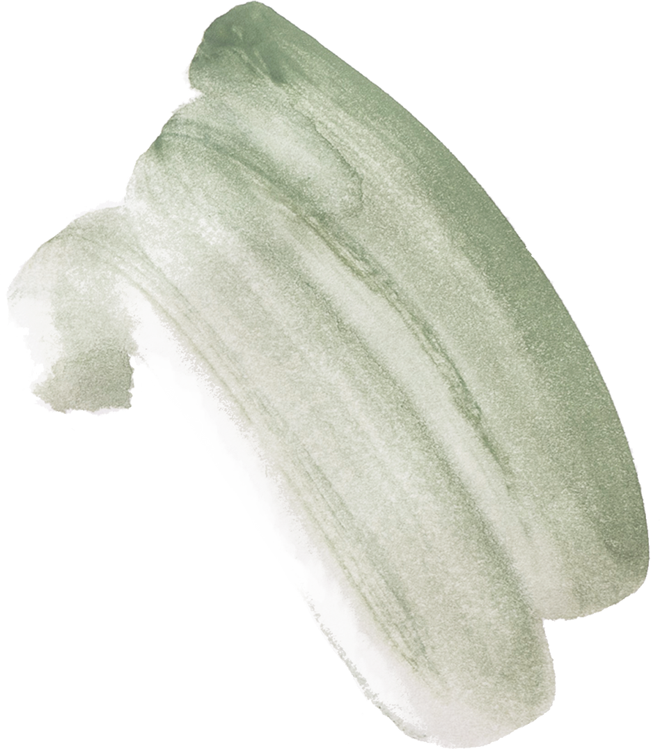

CHURN_MODELLING
Dataset Link https://www.kaggle.com/datasets/shrutimechlearn/churn-modelling

Slide 2

TABLE OF CONTENTS
Team Members
1
Intriduction And Dataset link
2
Dataset Description and preprocessing
3 - 9
Models and Result
10 - 28
Conclusion.
29 - 31

Slide 3
team members
Name | Id
فرح اسامة رؤوف عبد القادر | 20201700577
ماهيتاب احمد محمد نجيب | 20201700644
فاطمه طلبه عبدالنعيم عبدالله | 20201700569
هند محمد مصطفي | 20201701180
اسراء فتحي عبدالله صالح | 20201700112
شهد خالد فتح الباب عبد الوهاب | 20201701170
01

Slide 4

INTRODUCTION
In this dataset we have details of bank's customers and our problem is to find out if the customer will leave the bank or not so we used classification models to classify every customer if he will leave or not depending on his details.
DATASET LINK
https://www.kaggle.com/datasets/shrutimechlearn/churn-modelling
02

Slide 5
Dataset Description and preprocessing
Dataset Description
This data set contains details of a bank's customers and the target variable is a binary variable reflecting the fact whether the customer left the bank (closed his account) or continues to be a customer.
It consists of 10,000 records and includes 14 columns of various types of data. Here's a breakdown of the columns
03

Slide 6
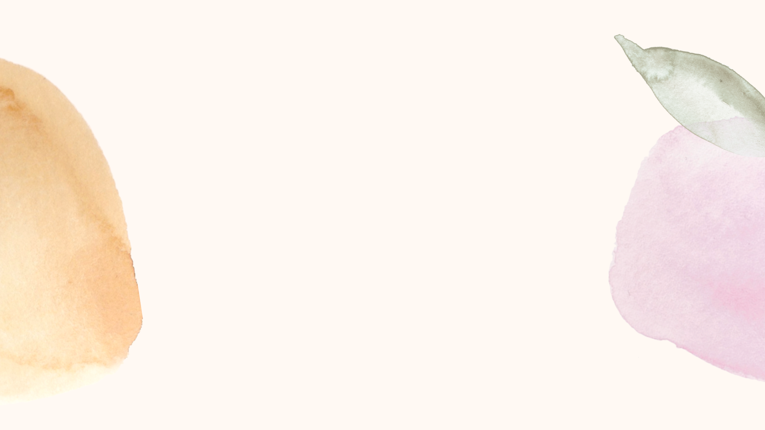
RowNumber
CustomerId
An index for each row
Unique identifier for each customer.
surname
CreditScore
Customer's surname.
Numerical value representing the credit score of the customer.
Geography
Gender
Categorical variable indicating the country of the customer (France, Spain, Germany).
Categorical variable for the customer's gender(Female, Male).
04

Slide 7

Age
Tenure
Numerical value representing the customer's age.
Number of years the customer has been with the bank.
Balance
NumOfProducts
Amount of money held in the customer's account.
Number of bank products the customer uses.
HasCrCard
IsActiveMember
Binary variable indicating if the customer has a credit card (1 for yes, 0 for no).
Binary variable indicating if the customer is an active member (1 for yes, 0 for no).
05

Slide 8
EstimatedSalary
Exited
Binary variable indicating whether the customer exited the bank (1 for yes, 0 for no), i.e., churn status.
Estimated salary of the customer.
finally
The dataset seems to aim at predicting customer churn based on various features like demographics, financial behavior, and tenure with the bank. This type of dataset is often used in machine learning projects to build predictive models that can anticipate which customers are more likely to leave the bank, allowing the bank to take proactive measures to retain them.
06

Slide 9
preprocesing

Slide 10
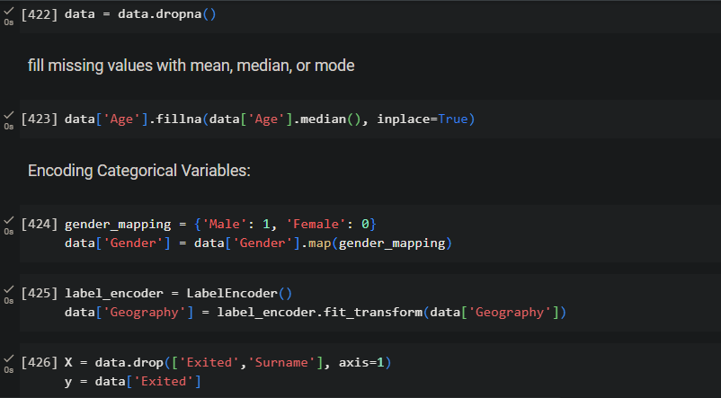
08

Slide 11
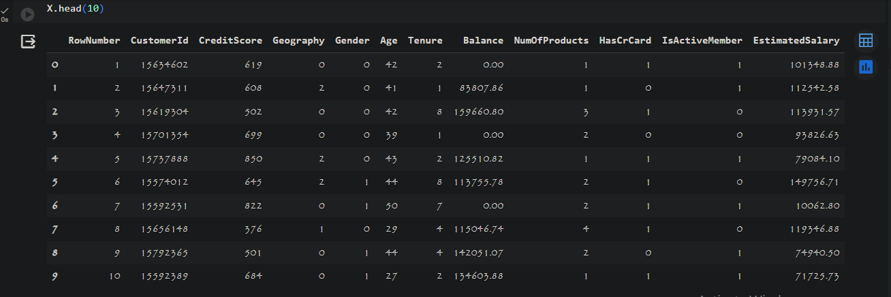
09

Slide 12
models

Slide 13
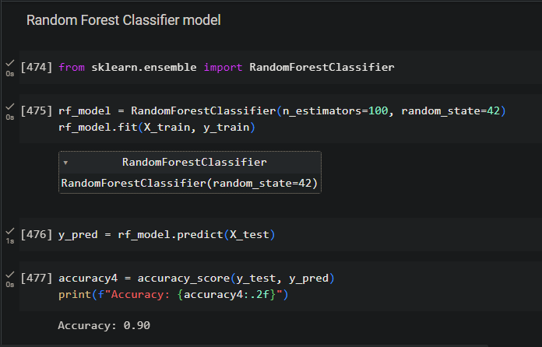
Random Forest
11

Slide 14
Why Random Forest Model
1.It's known for its high accuracy and robust performance across a variety of datasets
2.It works well with both categorical and numerical features, handling missing values and outliers effectively.
3.Random Forest provides a feature importance score, indicating which features have the most impact on the model's predictions.
4.By aggregating predictions from multiple trees, it minimizes overfitting compared to a single decision tree model.
5.It can handle large datasets efficiently due to its ability to parallelize the training process.
6.It's less sensitive to noise and outliers in the dataset compared to some other models.
12

Slide 15

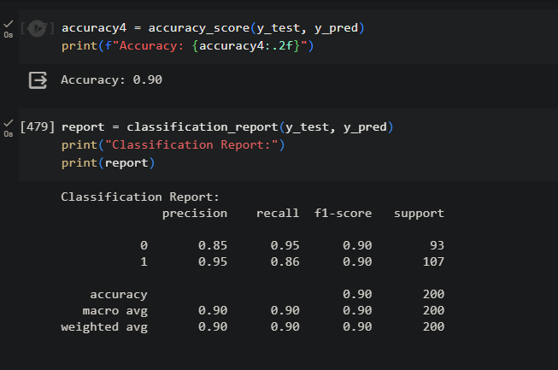
Random
Result
13

Slide 16
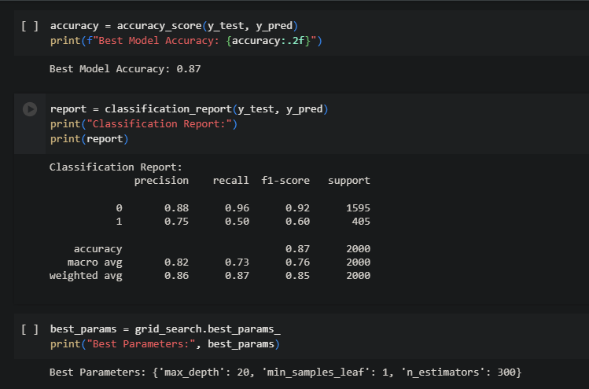
Modification Made
We tried to get the best accuracy by change the hyperparameters( n_estimators,max_depth, min_sample_leaf)
so, we got that n_estimators=300,max_depth=20,min_sample_leaf=1
14

Slide 17

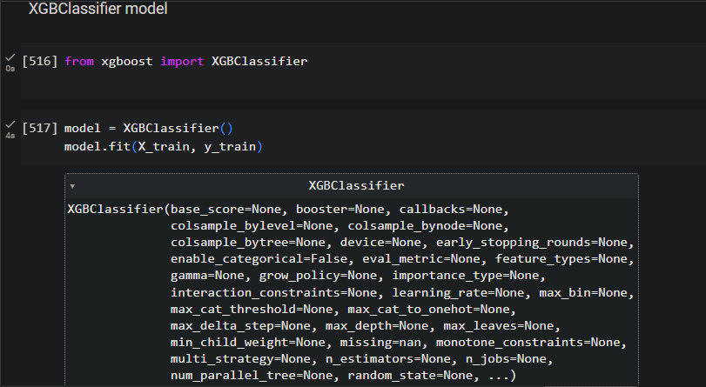
XGBClassifier model
15

Slide 18
Why XGBClassifier Model
Why XGB Model M
1.It's an ensemble learning method that combines the outputs from multiple individual models (decision trees) to produce a strong,
more generalized model.
2.It's optimized for speed and efficiency, making it scalable to large datasets.
3.XGBoost includes regularization techniques that help prevent overfitting, improving generalization to unseen data.
4.It can handle missing data effectively by learning how to treat missing values during the training process.
5. The flexibility of tuning hyperparameters allows for fine-tuning to improve performance for specific tasks.
6. XGBoost can be used for both classification and regression tasks, making it versatile across different problem types.
16

Slide 19
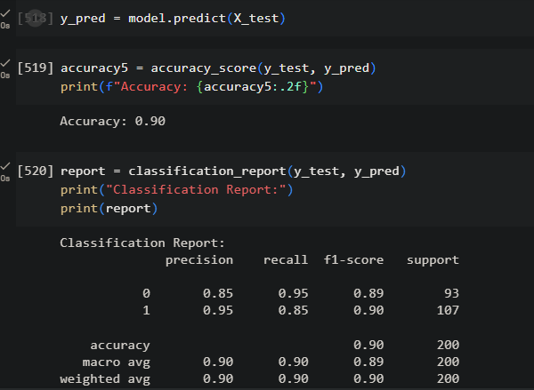
XGB
Result
17

Slide 20
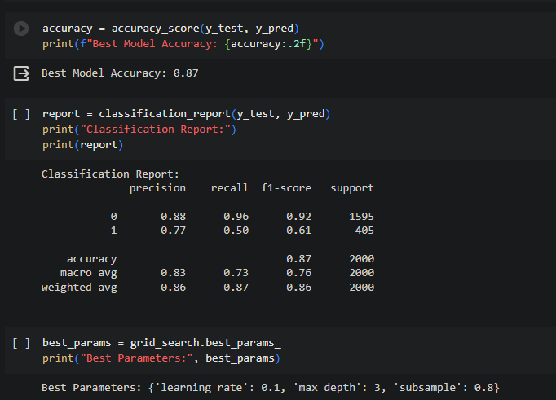
Modification Made
We tried to get the best accuracy by changing the hyperparameters( learning_rate,max_depth, subsample)
so, we got that learning_rate=0.1,max_depth=3,subsample=0.8
18

Slide 21
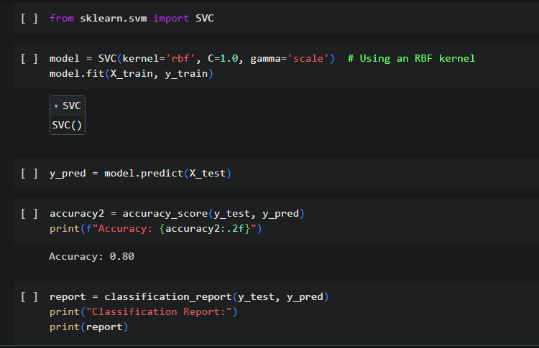
SVM Model
19

Slide 22
Why SVM Model
1.SVMs perform well even in high-dimensional spaces, making them suitable for tasks with many features.
2.They can model non-linear decision boundaries by using different kernel functions
like polynomial,radial basis function (RBF), or sigmoid.
3.SVMs work well when there is a clear margin of separation between classes.
4.They aim to find the optimal hyperplane that maximizes this margin.
5.SVMs are less prone to overfitting, especially in high-dimensional spaces, compared to some other classifiers.
20

Slide 23
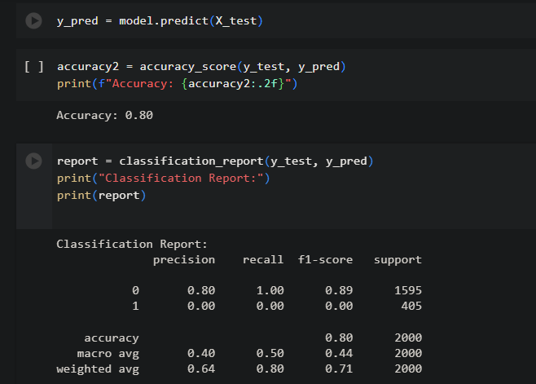
SVM Result
20
17

Slide 24
Modification Made
We tried to get the best accuracy by doing :
1-GridSearchCV 2-RandomizedSearchCV
by changing the hyperparameters( Regularization parameter values
, Kernel coefficient for 'rbf')
02

Slide 25
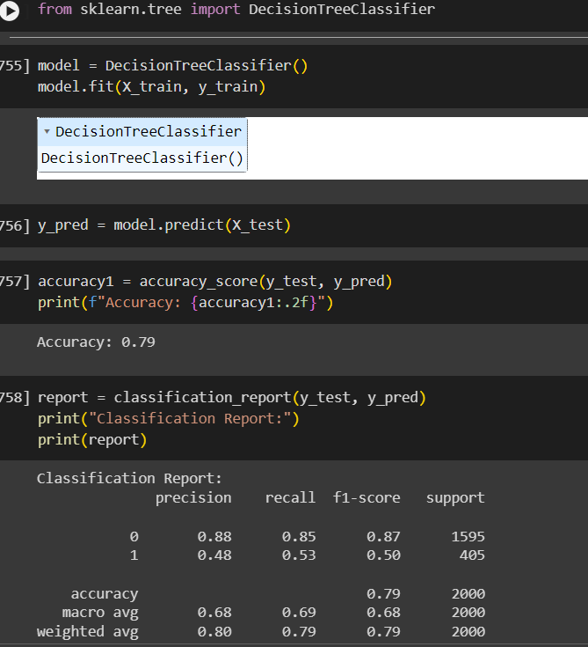
Decition Tree
Result
18

Slide 26
WHY DECISION TREE MODEL
1.Decision trees are easy to visualize and interpret,They mimic human decision- making by dividing the data into branches based on features.
2.They can handle non-linear relationships between features and the target variable effectively.
3.They're suitable for both numerical and categorical data without requiring extensive preprocessing.
4. They can handle both linear and non-linear relationships without the need for normalization.
5.They automatically select the most important features by placing them higher in the tree.
6.They are relatively fast to train and can handle large datasets.
02

Slide 27
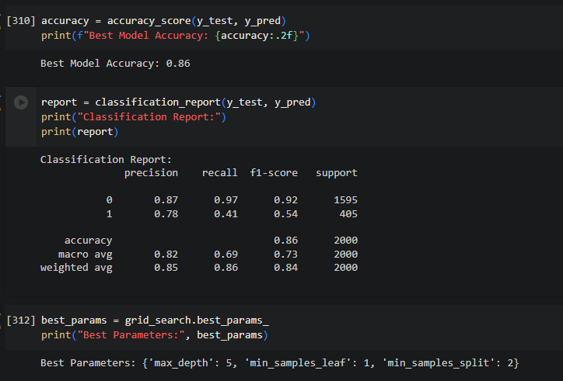
Modification Made
We tried to get the best accuracy by changing the hyperparameters( max_depth, min_sampel_split,min_sampel_leaf)
Best Parameters: max_depth= 5, min_samples_leaf=1,min_samples_split= 2}
02

Slide 28
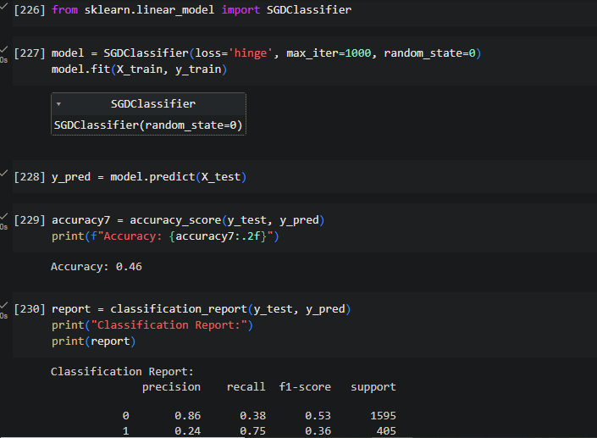
Stochastic Gradient Descent model
19

Slide 29
Why Stochastic Gradient Descent Model
1.SGD works well with large datasets because it updates the model's parameters using a single training example at a time.
2.It's adaptable to different loss functions for classification, regression, and other tasks.
This flexibility allows it to handle various types of problems.
3.It supports online learning, meaning it can continuously learn from new data in real-time,
which is beneficial in scenarios where the data is constantly changing or streaming.
4.It incorporates regularization techniques like L1 and L2 regularization to prevent overfitting, making it more robust against noisy data.
20

Slide 30
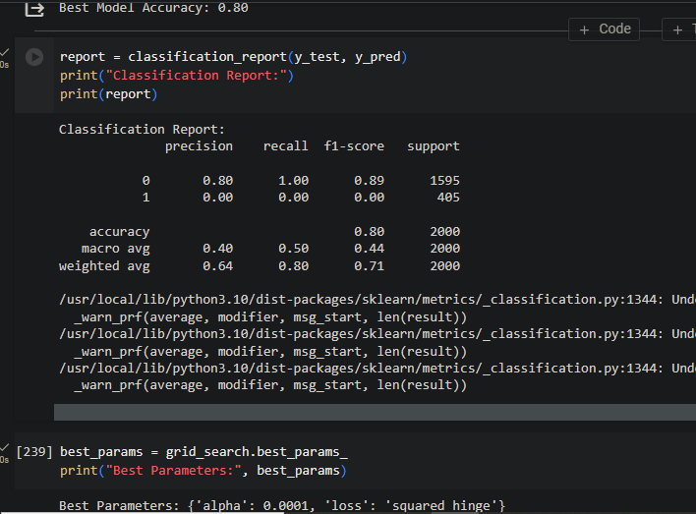
Modification Made
We tried to get the best accuracy by changing the hyperparameters(loss,alpha)
Best Parameters: alpha=0.0001,
loss= squared_hinge
21

Slide 31

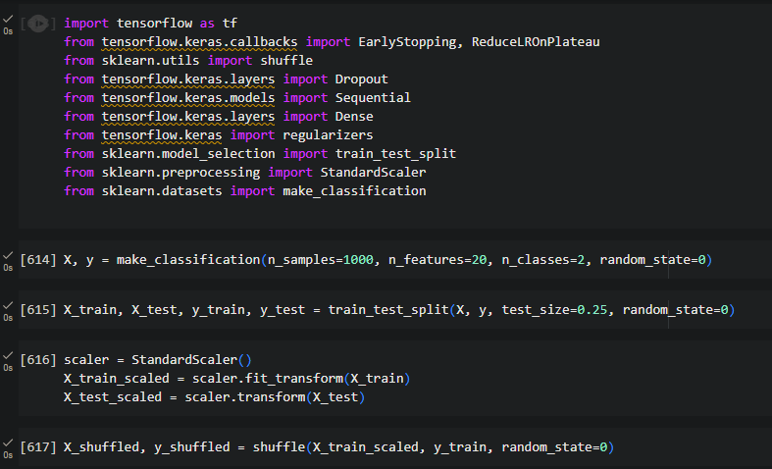
From Scratch Model
22

Slide 32
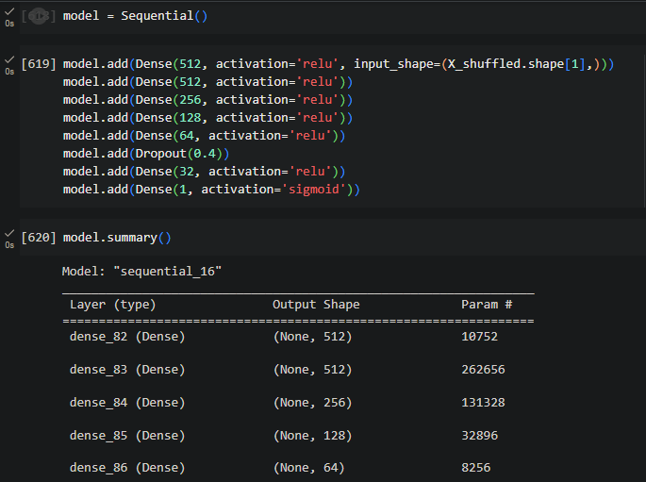
23

Slide 33
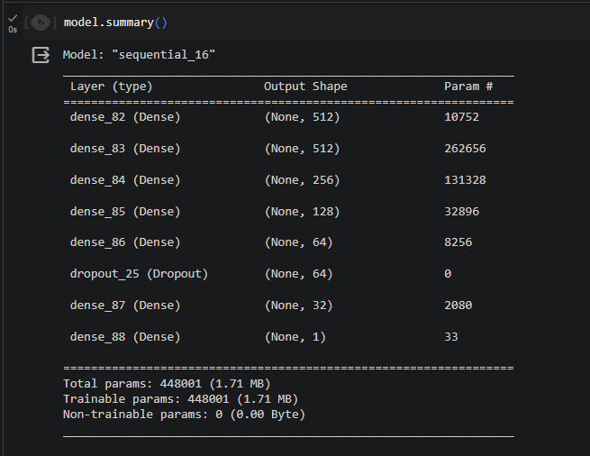
24

Slide 34
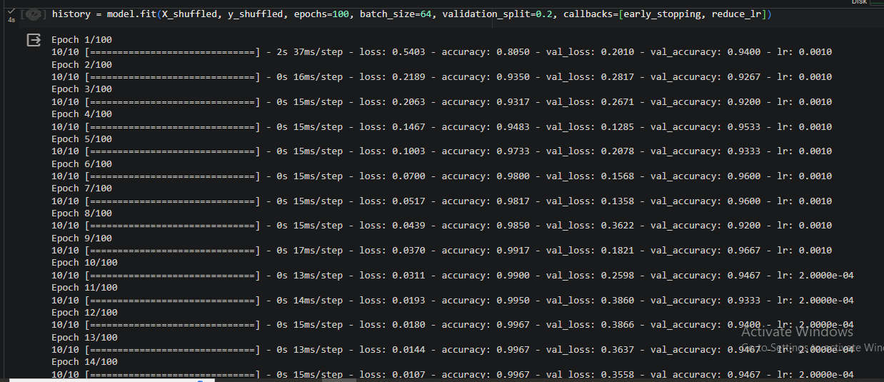
25

Slide 35
From Scratch Result

Slide 36
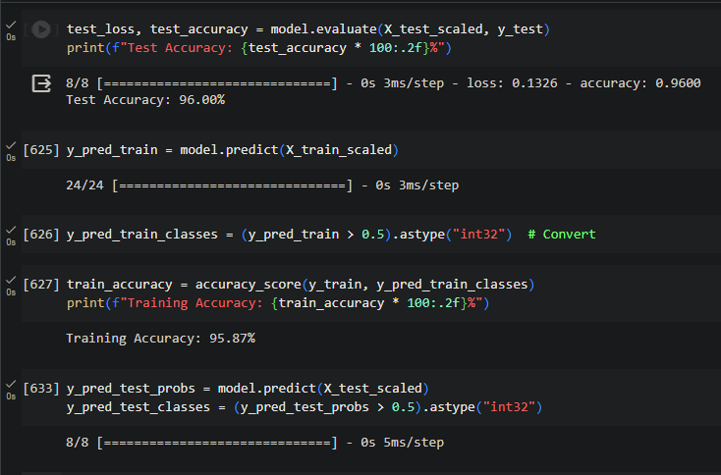
26

Slide 37
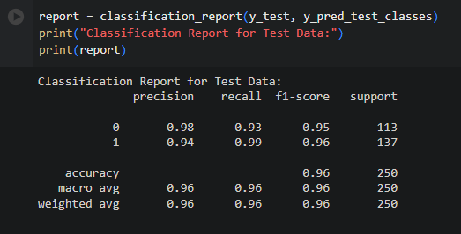
28

Slide 38
Conclusion.
we tried so many models and we find out that the best classifiers for our problem is random forest and xgb classifiers and in the following we discuss how we reached the best accuracy for every one of these two models:
in random forest model, we first got 90% accuracy and without changing anything it reduced to 87% we tried to change the hyperparameters and use grid search to reach the same accuracy but it stopped changing and became fixed so we reached 87% accuracy with these hyperparameters mentioned it slide 16.
in xgb we first got 85% accuracy and we changed in hyperparameters as mentioned it slide 20 to reach the best accuracy we could get which is 87%.
29

Slide 39
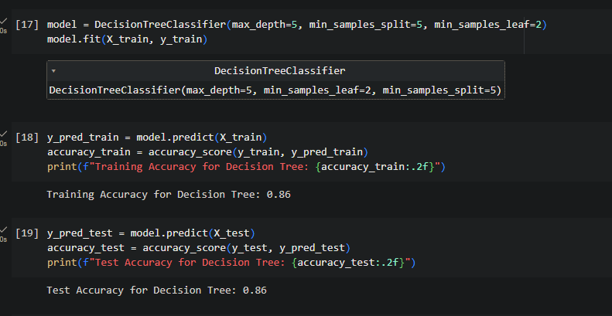
we also suffered from over fitting in the following model:
Decision Tree model : we solved it using these modification :-
30

Slide 40
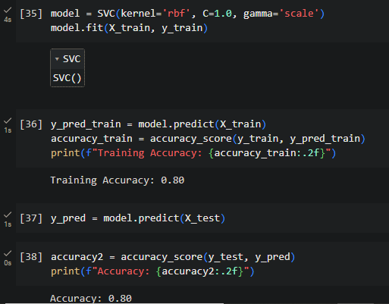
Svm classifier: and we solved it using these modification :-
31

Slide 41
Thank You

